Slide 1
Relational Model / Relational Algebra
Structure of Relational Databases
Relational Algebra
Tuple Relational Calculus
Domain Relational Calculus
Extended Relational-Algebra-Operations
Modification of the Database
Views

Slide 2

Example of a Relation

Slide 3
Basic Structure
Formally, given sets D₁, D₂, …. D_{n} a relation r is a subset of
D₁ x D₂ x … x D_{n}
Thus a relation is a set of n-tuples (a₁, a₂, …, a_{n}) where
each a_{i} ∈ D_{i}
Example: if
customer-name = {Jones, Smith, Curry, Lindsay}
customer-street = {Main, North, Park}
customer-city = {Harrison, Rye, Pittsfield}
Then r = { (Jones, Main, Harrison),
(Smith, North, Rye),
(Curry, North, Rye),
(Lindsay, Park, Pittsfield)}
is a relation over customer-name x customer-street x customer-city

Slide 4
Attribute Types
Each attribute of a relation has a name
The set of allowed values for each attribute is called the domain of the attribute
Attribute values are (normally) required to be atomic, that is, indivisible
  E.g. multivalued attribute values are not atomic
  E.g. composite attribute values are not atomic
The special value null is a member of every domain
The null value causes complications in the definition of many operations
  we shall ignore the effect of null values in our main presentation and consider their effect later

Slide 5
Relation Schema
A₁, A₂, …, A_{n} are attributes
R = (A₁, A₂, …, A_{n} ) is a relation schema
E.g. Customer-schema =
(customer-name, customer-street, customer-city)
r(R) is a relation on the relation schema R
E.g. customer (Customer-schema)

Slide 6
Relation Instance
The current values (relation instance) of a relation are specified by a table
An element t of r is a tuple, represented by a row in a table
attributes
(or columns)
customer-name
customer-street
customer-city
Jones
Smith
Curry
Lindsay
Main
North
North
Park
Harrison
Rye
Rye
Pittsfield
tuples
(or rows)
customer

Slide 7
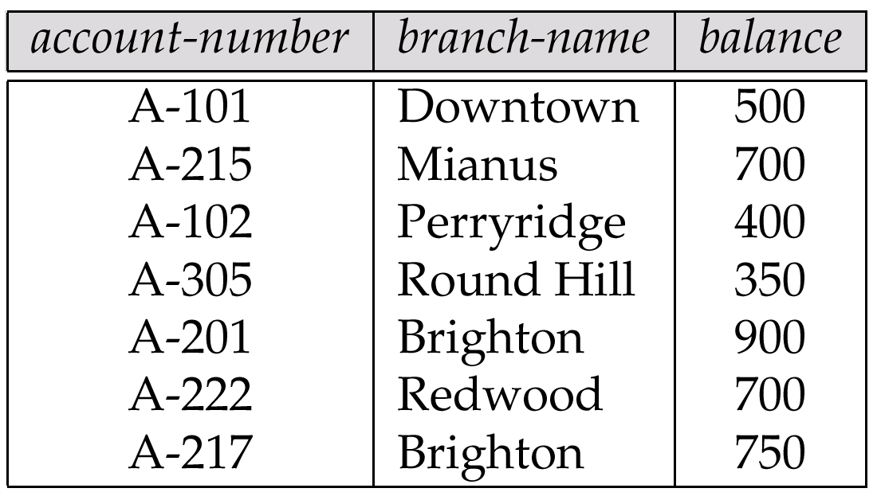
Relations are Unordered
Order of tuples is irrelevant (tuples may be stored in an arbitrary order)
E.g. account relation with unordered tuples [application of Group By doesn’t hold]

Slide 8
Database
A database consists of multiple relations
Information about an enterprise is broken up into parts, with each relation storing one part of the information
E.g.: account : stores information about accounts
depositor : stores information about which customer
owns which account
customer : stores information about customers
Storing all information as a single relation such as
bank(account-number, balance, customer-name, ..)
results in
  repetition of information (e.g. two customers own an account)
  the need for null values (e.g. represent a customer without an account)
Normalization theory (In next Chapter) deals with how to design relational schemas

Slide 9

The customer Relation

Slide 10

The depositor Relation

Slide 11
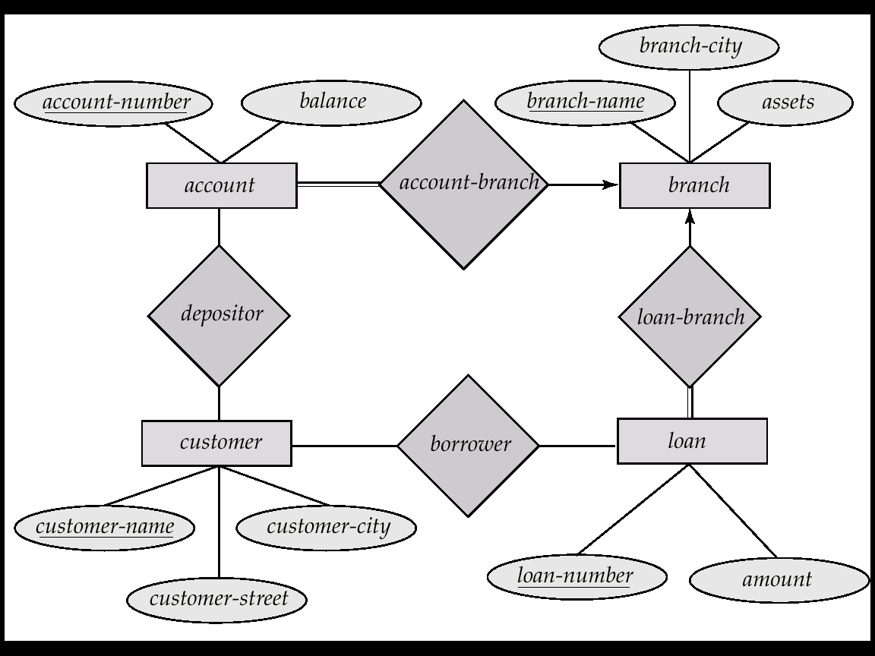
E-R Diagram for the Banking Enterprise

Slide 12
Keys
Let K ⊆ R
K is a superkey of R if values for K are sufficient to identify a unique tuple of each possible relation r(R)
  by “possible r” we mean a relation r that could exist in the enterprise we are modeling.
  Example: {customer-name, customer-street} and
  {customer-name}
  are both superkeys of Customer, if no two customers can possibly have the same name.
K is a candidate key if K is minimal
Example: {customer-name} is a candidate key for Customer, since it is a superkey (assuming no two customers can possibly have the same name), and no subset of it is a superkey.

Slide 13
Determining Keys from E-R Sets
Strong entity set. The primary key of the entity set becomes the primary key of the relation.
Weak entity set. The primary key of the relation consists of the union of the primary key of the strong entity set and the discriminator of the weak entity set.
Relationship set. The union of the primary keys of the related entity sets becomes a super key of the relation.
  For binary many-to-one relationship sets, the primary key of the “many” entity set becomes the relation’s primary key.
  For one-to-one relationship sets, the relation’s primary key can be that of either entity set.
  For many-to-many relationship sets, the union of the primary keys becomes the relation’s primary key

Slide 14

Schema Diagram for the Banking Enterprise

Slide 15
Query Languages
Language in which user requests information from the database.
Categories of languages
  procedural
  non-procedural
“Pure” languages:
  Relational Algebra
  Tuple Relational Calculus
  Domain Relational Calculus
Pure languages form underlying basis of query languages that people use.

Slide 16
Relational Algebra
Procedural language
Six basic operators
  select
  project
  union
  set difference
  Cartesian product
  rename
The operators take one or more relations as inputs and give a new relation as a result.

Slide 17
Select Operation – Example
Relation r
A
B
C
D








1
5
12
23
7
7
3
10
_{A=B ^ D > 5} (r)
A
B
C
D




1
23
7
10

Slide 18
Select Operation
Notation: σ _{p}(r)
p is called the selection predicate
Defined as:
σ_{p}(r) = {t | t ∈ r and p(t)}
Where p is a formula in propositional calculus consisting of terms connected by : ∧ (and), ∨ (or), ¬ (not)
Each term is one of:
<attribute> op <attribute> or <constant>
where op or operator is one of: =, ≠, >, ≥. <. ≤
Example of selection:
σ _{branch-name=“Perryridge”}(account)

Slide 19
Project Operation – Example
A
B
C
Relation r:




10
20
30
40
1
1
1
2
A
C
A
C
_{A,C} (r)




1
1
1
2



1
1
2
=

Slide 20
Project Operation
Notation:
∏_{A1, A2, …, Ak} (r)
where A₁, A₂ are attribute names and r is a relation name.
The result is defined as the relation of k columns obtained by erasing the columns that are not listed
Duplicate rows removed from result, since relations are sets
E.g. To eliminate the branch-name attribute of account
∏_{account-number, balance} (account)

Slide 21
Union Operation – Example
Relations r, s:
A
B
A
B



1
2
1


2
3
s
r
r  s:
A
B




1
2
1
3

Slide 22
Union Operation
Notation: r ∪ s
Defined as:
r ∪ s = {t | t ∈ r or t ∈ s}
For r ∪ s to be valid.
1. r, s must have the same arity (same number of attributes)
2. The attribute domains must be compatible (e.g., 2nd column
of r deals with the same type of values as does the 2nd
column of s)
E.g. to find all customers with either an account or a loan
∏_{customer-name} (depositor) ∪ ∏_{customer-name} (borrower)

Slide 23
Set Difference Operation – Example
Relations r, s:
A
B
A
B



1
2
1


2
3
s
r
r – s:
A
B


1
1

Slide 24
Set Difference Operation
Notation r – s
Defined as:
r – s = {t | t ∈ r and t ∉ s}
Set differences must be taken between compatible relations.
  r and s must have the same arity
  attribute domains of r and s must be compatible

Slide 25
Cartesian-Product Operation-Example
A
B
C
D
E
Relations r, s:


1
2




10
10
20
10
a
a
b
b
r
s
r x s:
A
B
C
D
E








1
1
1
1
2
2
2
2








10
10
20
10
10
10
20
10
a
a
b
b
a
a
b
b

Slide 26
Cartesian-Product Operation
Notation r x s
Defined as:
r x s = {t q | t ∈ r and q ∈ s}
Assume that attributes of r(R) and s(S) are disjoint. (That is,
R ∩ S = ∅).
If attributes of r(R) and s(S) are not disjoint, then renaming must be used.

Slide 27
Composition of Operations
Can build expressions using multiple operations
Example: σ_{A=C}(r x s)
r x s
σ_{A=C}(r x s)
A
B
C
D
E








1
1
1
1
2
2
2
2








10
10
20
10
10
10
20
10
a
a
b
b
a
a
b
b
A
B
C
D
E



1
2
2



10
20
20
a
a
b

Slide 28
Rename Operation
Allows us to name, and therefore to refer to, the results of relational-algebra expressions.
Allows us to refer to a relation by more than one name.
Example:
ρ _{x} (E)
returns the expression E under the name X
If a relational-algebra expression E has arity n, then
ρ_{x} _{(A1, A2, …, An)} (E)
returns the result of expression E under the name X, and with the
attributes renamed to A1, A2, …., An.

